Slide 1

Time Interactive Notebook
Name
Class
Teacher
Term 4 Semester 2
1

Slide 2
Tasks
24
7
30
Essential Question
Questions
Notes
Summary
4
5

Slide 3
24
7
30
Date
Time Zones
EQ – What are time zones and how do they affect our lives?
Summary:
5

Slide 4
Time Zones Video
http://splash.abc.net.au/home#!/media/1950553/time-zones

Slide 5
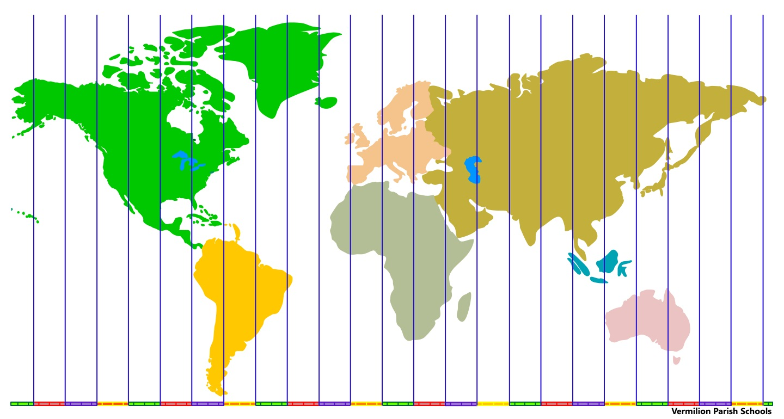
24
7
30
Date
Time Zones
EQ – What are time zones and how do they affect our lives?
Vocabulary
A time zone is a region of the earth that has the same time. There are 24 time zones.
5

Slide 6
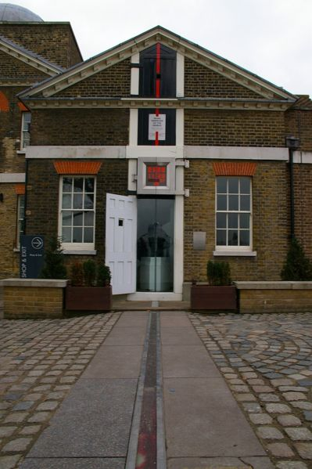
There are 24 standard time zones in the world (measured in hours)
There are also some non-standard time zones (measured in ½ hours)
Time zones start at the Prime Meridian (0 degrees Longitude)
Time Zones end at the International Date Line (Pacific Ocean)
The Prime Meridian runs through the city of Greenwich, England (GMT = Greenwich Mean Time)
East of GMT you add hours
West of GMT you subtract hours
Example: If it is 12 noon GMT and you are 10 time zones west of the Prime Meridian, then subtract 10 hours from 12noon (2am)

Slide 7
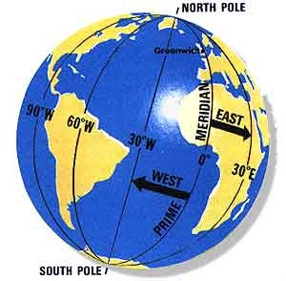
Greenwich, England is the starting point for time zones
The world rotates west to east (counterclockwise), time zones to the east are ahead of the those time zones to the west

Slide 8
LONGITUDE AND TIME
The world rotates (spins) _____° in ___ hours.
How many degrees per hour does the earth spin?
360° / 24 hours = 15° per hour
The world has 24 time zones, each 15° apart.
THERE IS A 1 HOUR TIME DIFFERENCE FOR EVERY 15° OF LONGITUDE (vertical lines on a map, similar to time zones)

Slide 9
24
7
30
Date
Time Zones
EQ – What are time zones and how do they affect our lives?
Think of it as a giant number line.
Greenwich, England is at 0 on the number line. As you move to the left you subtract, as you move to the right you add.
-2
Sandwich Islands
-1
Dakar
0
Greenwich
+1
Paris
+2
Cape Town
5

Slide 10
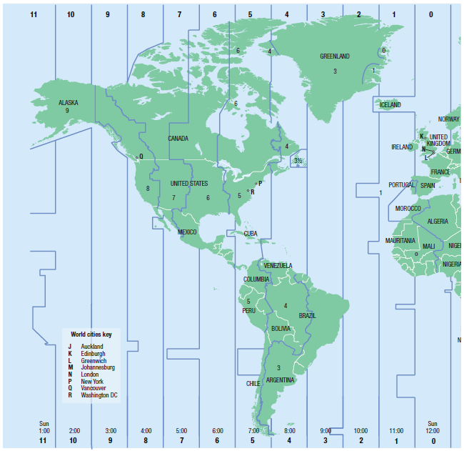
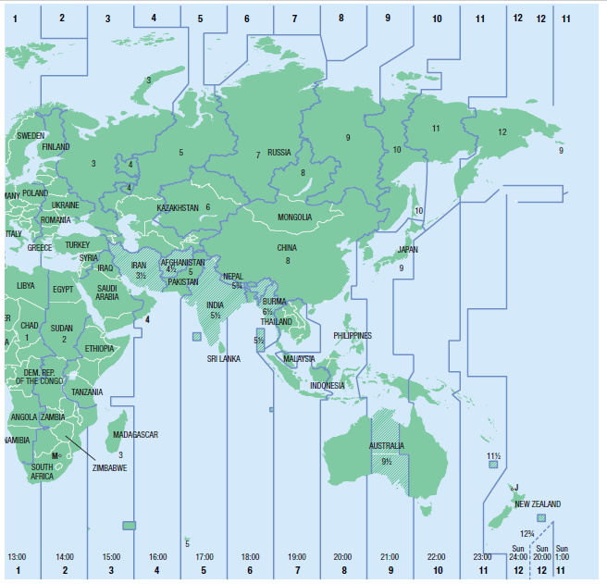
Time zones (World)
When it is 2:00 pm in Greenwich London, find the time in these places:
1) South Africa, 2) China, 3) New York, 4) Queensland and 5) Alaska

Slide 11
Time zones (World)
What is the time difference between:
1) India and China, 2) WA and New York, 3) Argentina and Alaska

Slide 12
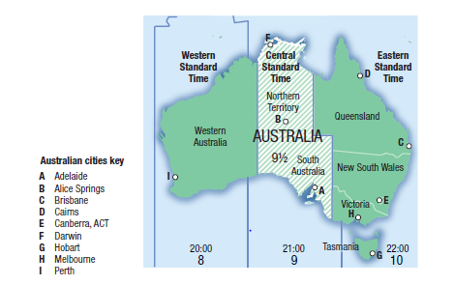
24
7
30
Date
Time Zones
EQ – What are the time zones in Australia?
How many time zones does Australia have?
There are three time zones in Australia
1. AEST (GMT+10) – Sydney, Melbourne, Brisbane, Gold Coast, Cairns, Hobart.
2. AWST (GMT+8 ) – Perth
3. ACST (GMT +9.5) – Darwin, Alice Spring and Adelaide
Summary:
5

Slide 13
Time zones (Australia)
When it is 9:35 am in New South Wales, Australia, find the time in these places.
i Alice Springs
ii Perth
iii London

Slide 14
You Do
Essential Mathematics 8, Exercise 4 J, Q 9-11, pg 235-236,

Slide 15
Plenary
List three things you learned today.
List three things your partner learned today.

